Slide 1
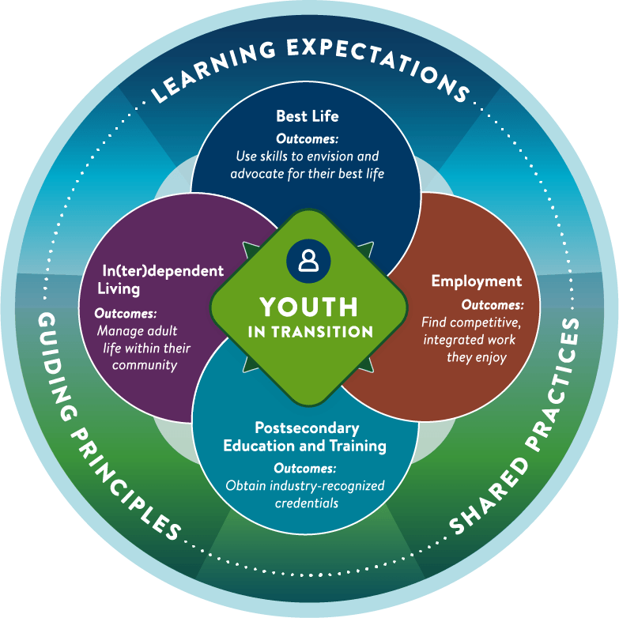
Minnesota’s Youth in Transition Framework
A Presentation to XYZ Group October 12, 2024

Slide 2
Minnesota’s Youth in Transition Framework defines quality transition planning, empowering professionals across the state to work together toward the same outcomes for youth.
MINNESOTA’S YOUTH IN TRANSITION FRAMEWORK
Developed by E1MN and transition leaders statewide.
Notes:
What is Minnesota’s Youth in Transition Framework? It is a statewide Framework to guide transition professionals with a vision of how their work can impact and improve the lives of youth and their families. The Framework was developed by E1MN and transition leaders statewide.

Slide 3
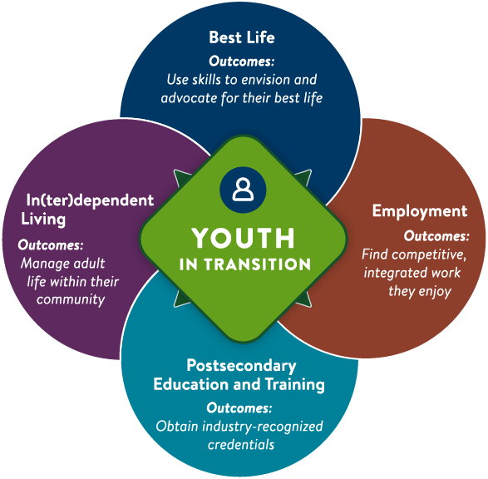
The Framework defines the improved youth outcomes all transition professionals in Minnesota are working toward.
MINNESOTA’S YOUTH IN TRANSITION FRAMEWORK
IMPROVED YOUTH OUTCOMES:
Best Life Youth use self-determination and leadership skills to envision and advocate for their best life.
In(ter)dependent Living Youth successfully manage in(ter)dependent adult life within their community.
Employment Youth find competitive, integrated work they enjoy.
Postsecondary Education and Training Youth access postsecondary education and training options and obtain industry-recognized credentials.
Notes:
The Framework defines quality transition planning, empowering professionals across the state to work together toward the same outcomes for youth. These outcomes are found in the center of the Framework graphic: Best Life, In(ter)dependent Living, Employment and Postsecondary Education and Training.

Slide 4
Why was the Framework created?
MINNESOTA’S YOUTH IN TRANSITION FRAMEWORK
THE FRAMEWORK WAS DEVELOPED BECAUSE:
Transition professionals and community partners did not know what was expected of them.
Families did not know what they could expect from transition planning.
Transition planning was not coordinated across agencies, which led to inefficient and frustrating experiences for youth and families.
Broad inconsistencies in programs and services created inequities for youth and families.

Slide 5
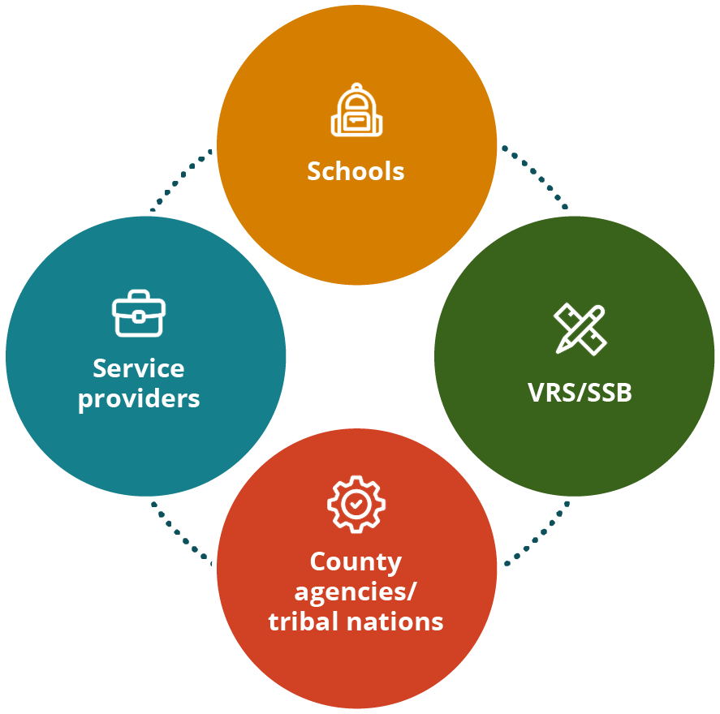
All transition professionals are asked to align their work to the Framework.
MINNESOTA’S YOUTH IN TRANSITION FRAMEWORK
STRENGTHENING PARTNERSHIPS BETWEEN:
Schools
Vocational Rehabilitation Services (VRS)/ State Services for the Blind (SSB)
County agencies/tribal nations
Service providers
These professionals are adopting the Framework into their programs and services, such as IEPs, 504 plans, waiver case management, Pre-ETS, employment plans, and more.
Notes:
Who should use Minnesota’s Youth in Transition Framework? All transition professionals in Minnesota are asked to align their work to the Framework and strengthen their partnerships and delivery of high-quality transition programs and services. Such transition professionals include those in schools, Vocational Rehabilitation Services (VRS) / State Services for the Blind (SSB), county agencies/tribal nations, and service providers who work on programs and services such as: Special education, IEPs, and 504 plans and accommodations, Waiver case management and coordinated services and supports plans, Vocational Rehabilitation, Pre-ETS and employment plans and more.

Slide 6
The Framework’s three key elements create the foundation for effective transition planning and programming.
ELEMENTS OF THE FRAMEWORK
Guiding principles
Learning expectations
Shared practices
Notes:
Minnesota’s Youth in Transition Framework is comprised of three key elements: Guiding principles, Learning expectations, and shared practices.

Slide 7
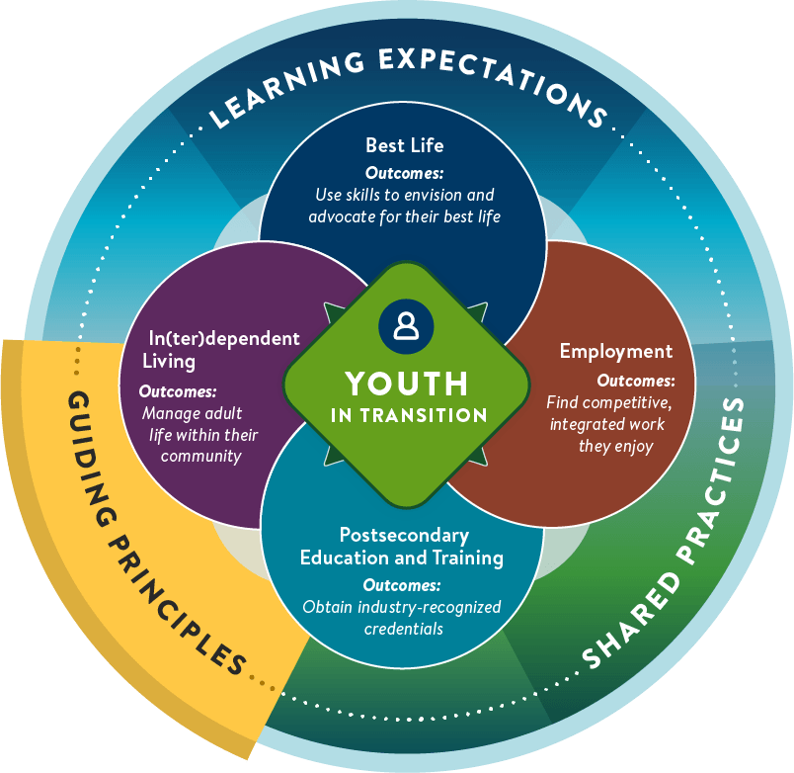
Guiding principles are the beliefs that guide decisions at the system, agency and professional level.
KEY ELEMENT OF THE FRAMEWORK
SIX GUIDING PRINCIPLES:
The youth is at the center of transition planning.
Families play a key role in successful transition outcomes.
Transition planning should start early in a youth’s life.
High expectations matter.
Strong partnerships support a smoother transition to adulthood.
Success is measured by improved youth outcomes.
These six principles serve as the foundation for what we do and how we do it.
Notes:
The first key element of the Framework, guiding principles, are the beliefs that guide decisions at the system, agency and professional level. These six principles serve as the foundation for what we do and how we do it.

Slide 8
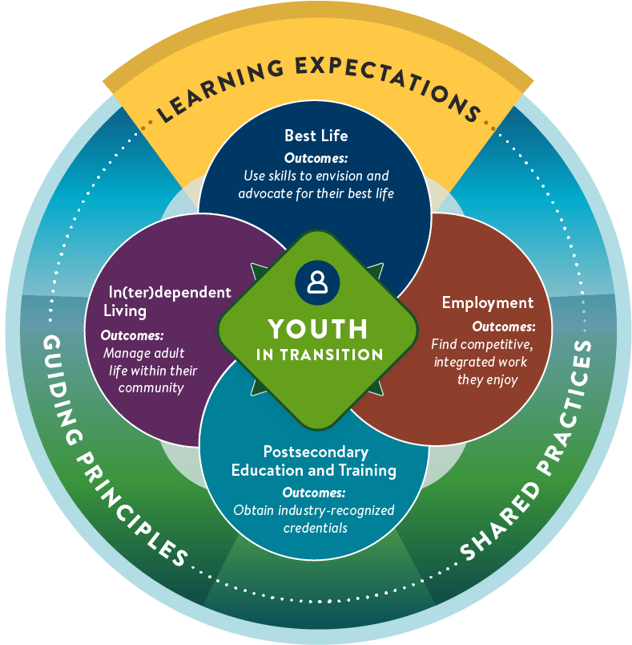
Learning expectations define the topics all youth in transition should explore.
KEY ELEMENT OF THE FRAMEWORK
TOPICS ARE ORGANIZED INTO FOUR CATEGORIES:
Best life
In(ter)dependent living
Employment
Postsecondary education and training
Exploration of topics in these four categories helps students develop the knowledge, skills and supports they need to prepare for and live the life they want in adulthood.
Notes:
The second key element of the Framework, learning expectations, define the topics all youth in transition in Minnesota should explore as a part of consistent, high-quality transition planning. Exploration of these topics helps students to develop the knowledge, skills and supports they need to prepare for and live the life they want in adulthood. The Framework’s learning topics are organized into four categories: My best life, In(ter)dependent living, Employment, and Postsecondary education and training. Note that each learning topic aligns with a specific Pre-Employment Transition Service (Pre-ETS).

Slide 9
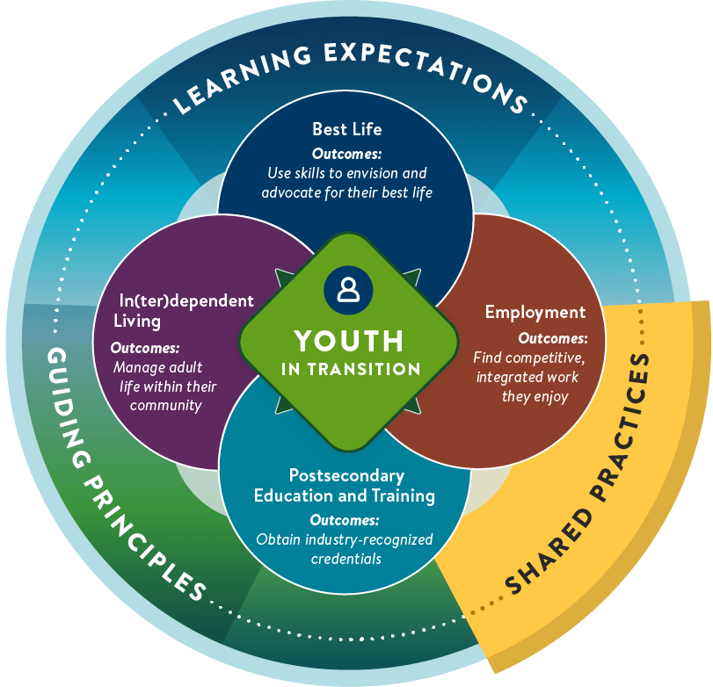
Shared practices are collective ways of working using the same practices, processes and tools to create consistent experiences.
KEY ELEMENT OF THE FRAMEWORK
THE FRAMEWORK’S THREE SHARED PRACTICES ARE:
Person-centered practices
Collaborative partnerships
The youth-planning process
The goal is consistent, person-centered experiences for youth and families while optimizing the role of everyone on the youth’s transition planning team.
Notes:
The third key element of the Framework, shared practices, are collective ways of working. When we all use the same practices, processes and tools, we can create consistent person-centered experiences for youth and families while optimizing the role of everyone on the youth’s transition planning team. Shared practices can result in better outcomes for youth, improve engagement by families and make the jobs of staff easier in the long run. The Framework’s shared practices are: Person-centered practices, collaborative partnerships and the youth planning process.

Slide 10
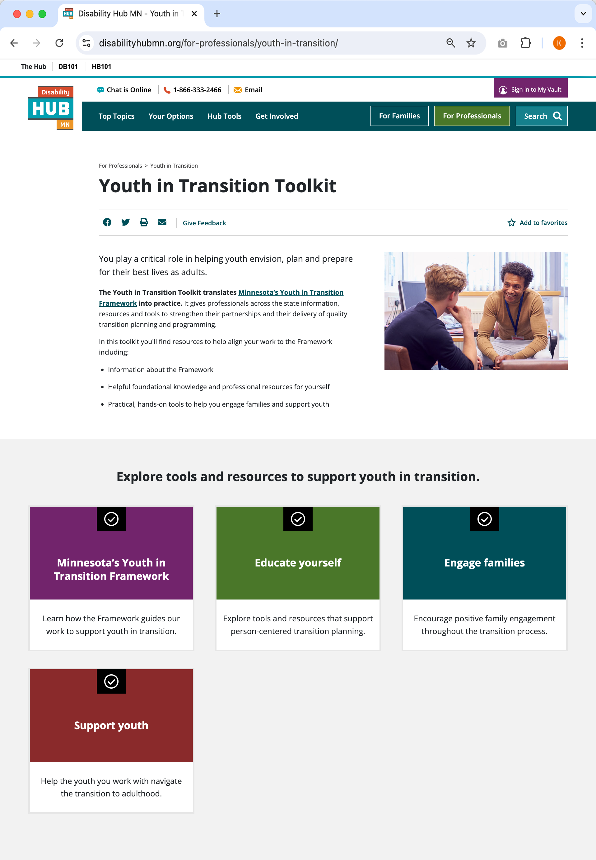
To support professionals in implementing Minnesota’s Youth in Transition Framework, a comprehensive toolkit is available online.
THE YOUTH IN TRANSITION TOOLKIT
The Youth in Transition Toolkit provides statewide access to up-to-date resources and tools to help professionals implement the Framework.
Check it out at disabilityhubmn.org/YIT-toolkit
Notes:
With the support of E1MN, the toolkit is hosted and maintained by Disability Hub MN—a statewide resource network for Minnesotans with disabilities and the people who support them.

Slide 11
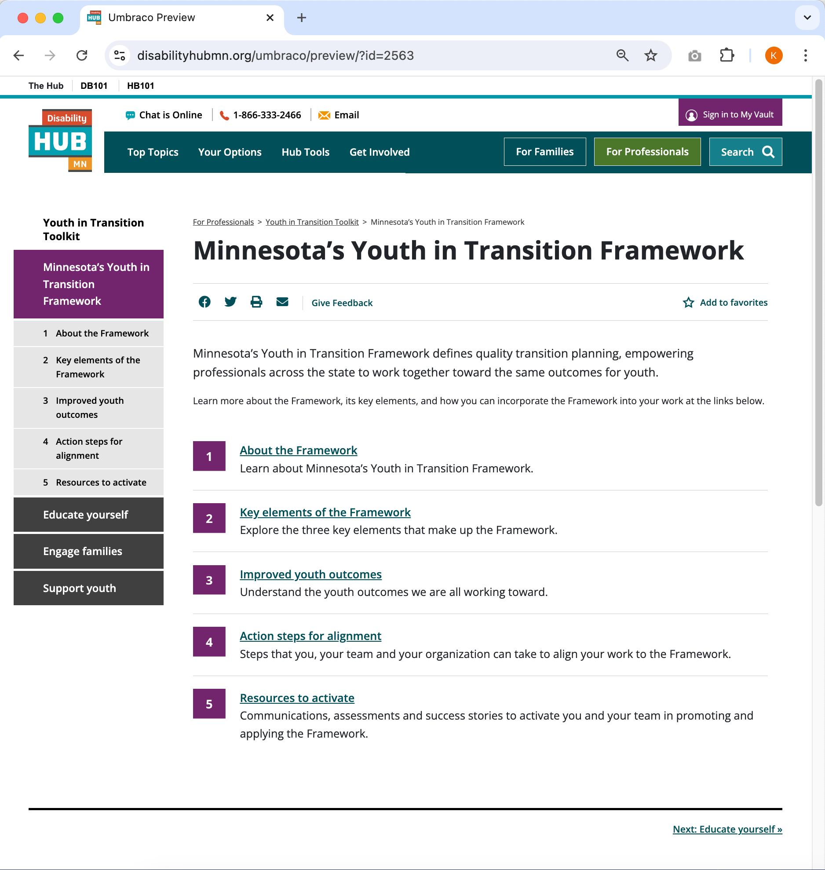
Minnesota’s Youth in Transition Framework section
THE YOUTH IN TRANSITION TOOLKIT
Professionals can start here to:
Learn about the Framework, its key elements, and outcomes
Find action steps for leadership and staff
Get resources to activate themselves and their teams
Notes:
Direct link to this page: https://disabilityhubmn.org/for-professionals/youth-in-transition/minnesota-s-youth-in-transition-framework/

Slide 12
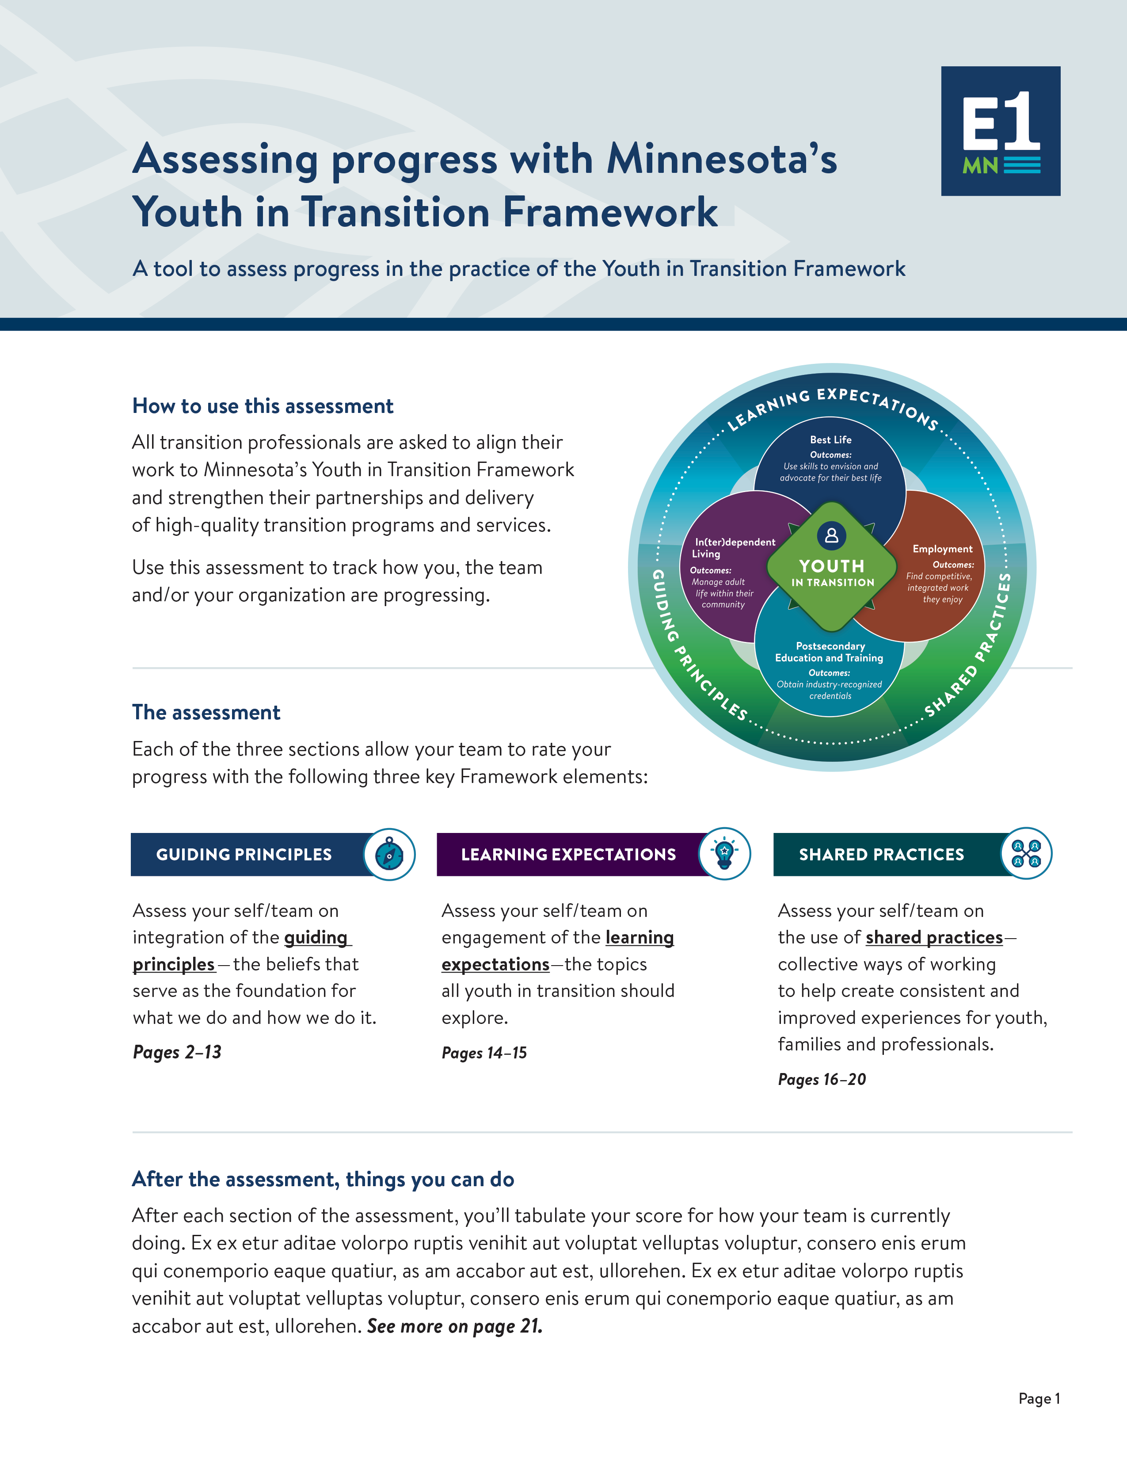
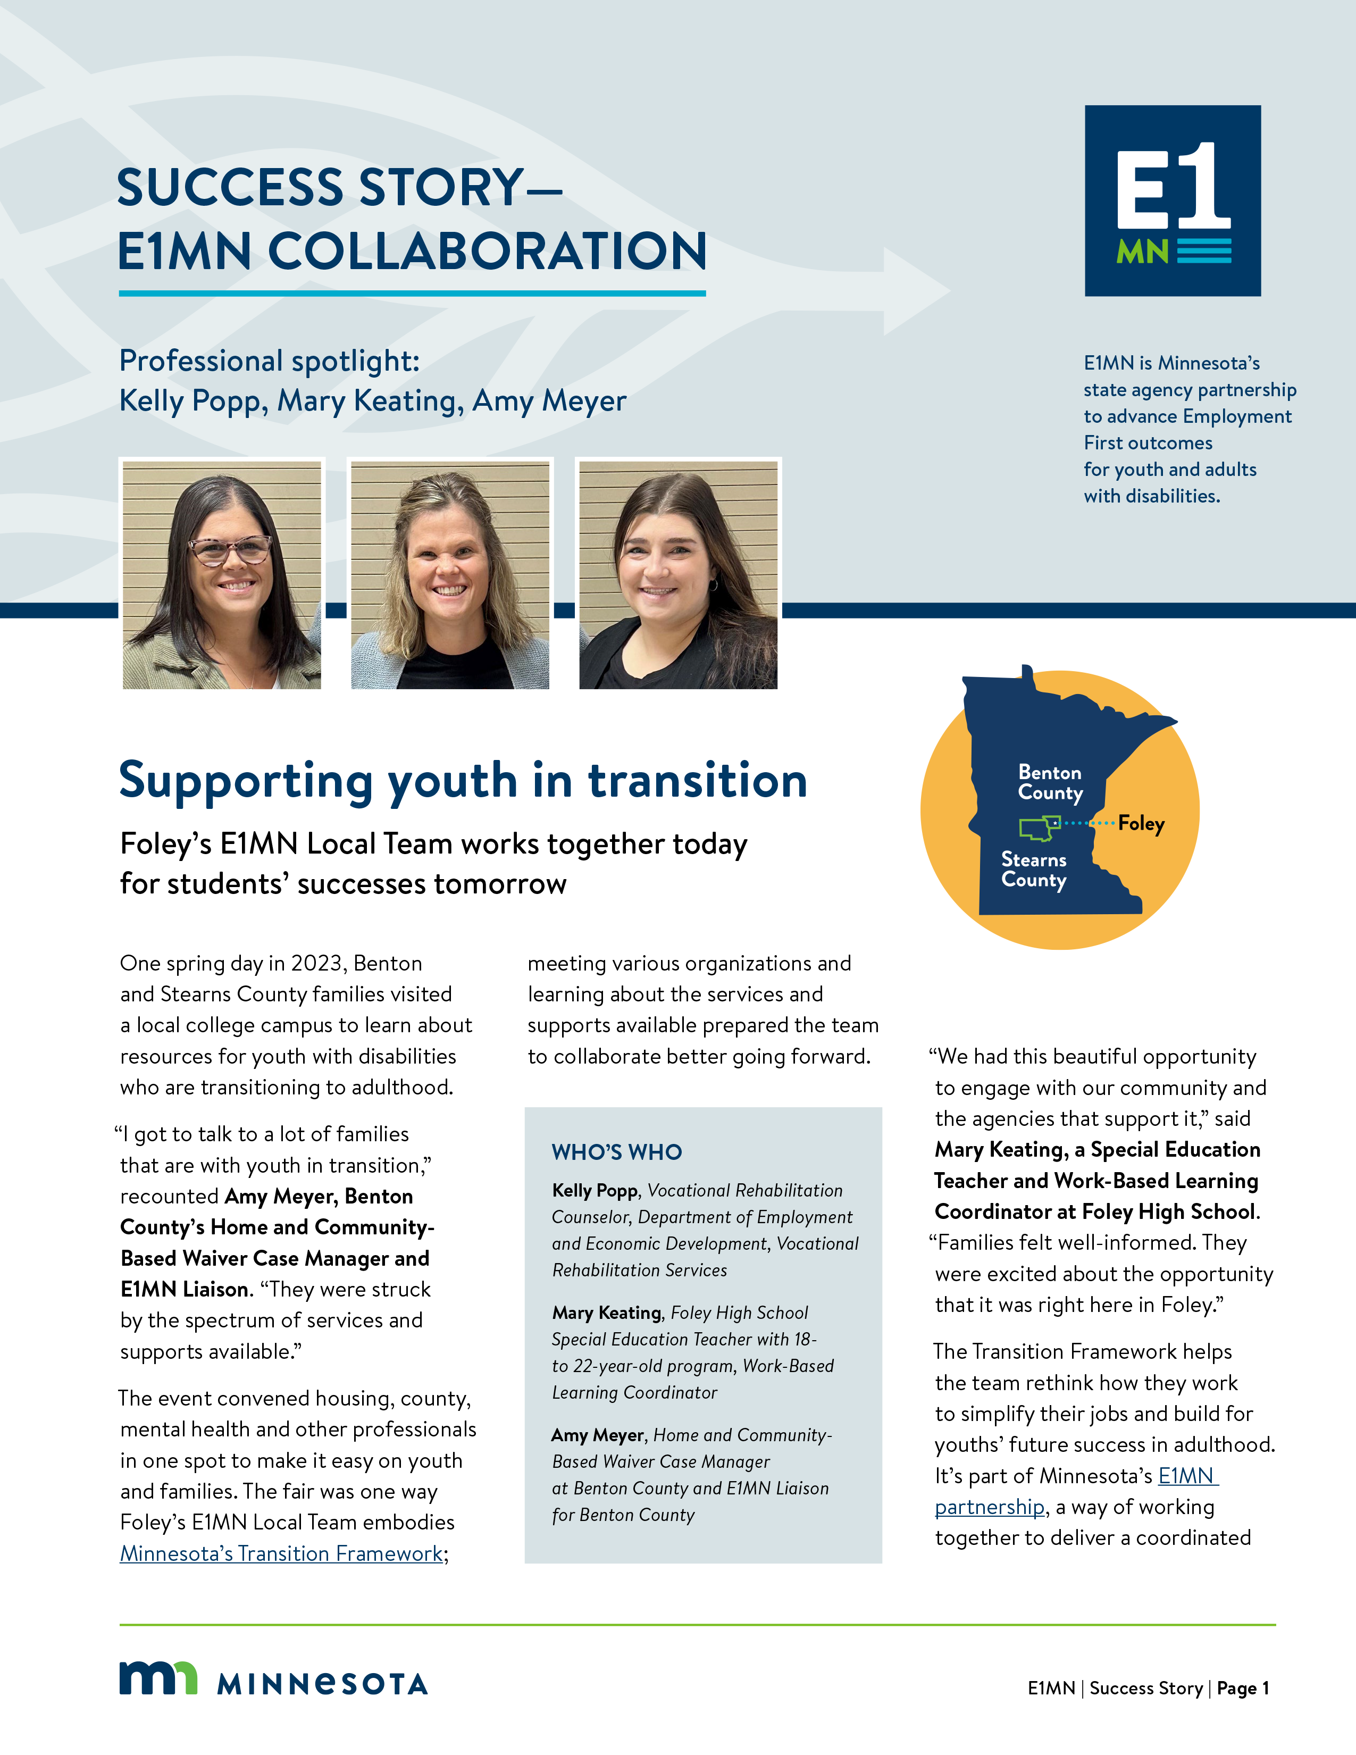
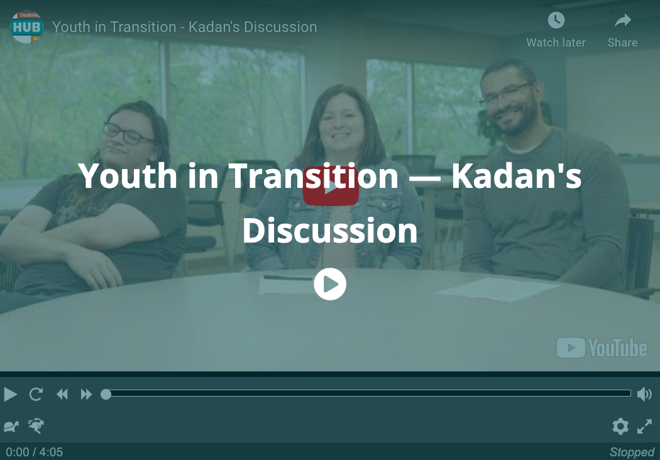
Resources to build and activate you and your teams
THE YOUTH IN TRANSITION TOOLKIT
In the ‘Resources to activate you and your teams’ section, professionals can:
Assess team progress in aligning to the Framework
Get tools to build a regional/local transition planning team and review student outcome data
Read and watch success stories of teams across the state of Minnesota
Share their success stories with others!
Notes:
Direct link to this page: https://disabilityhubmn.org/for-professionals/youth-in-transition/minnesota-s-youth-in-transition-framework/resources-to-activate-you-and-your-teams

Slide 13
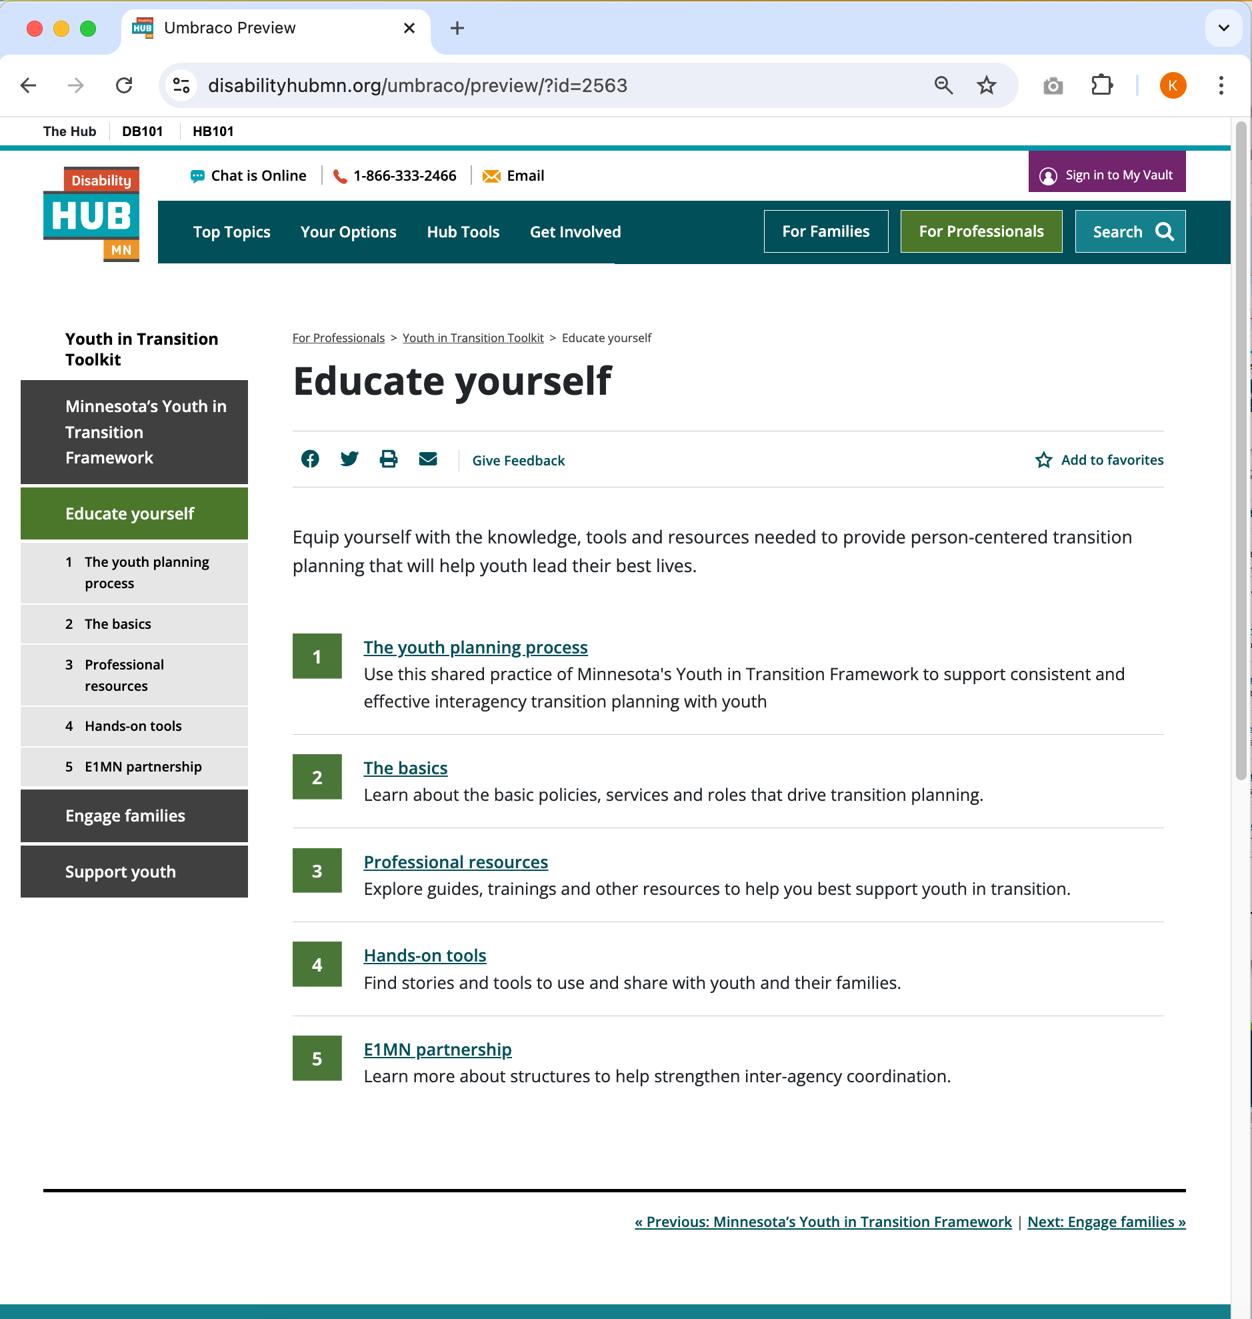
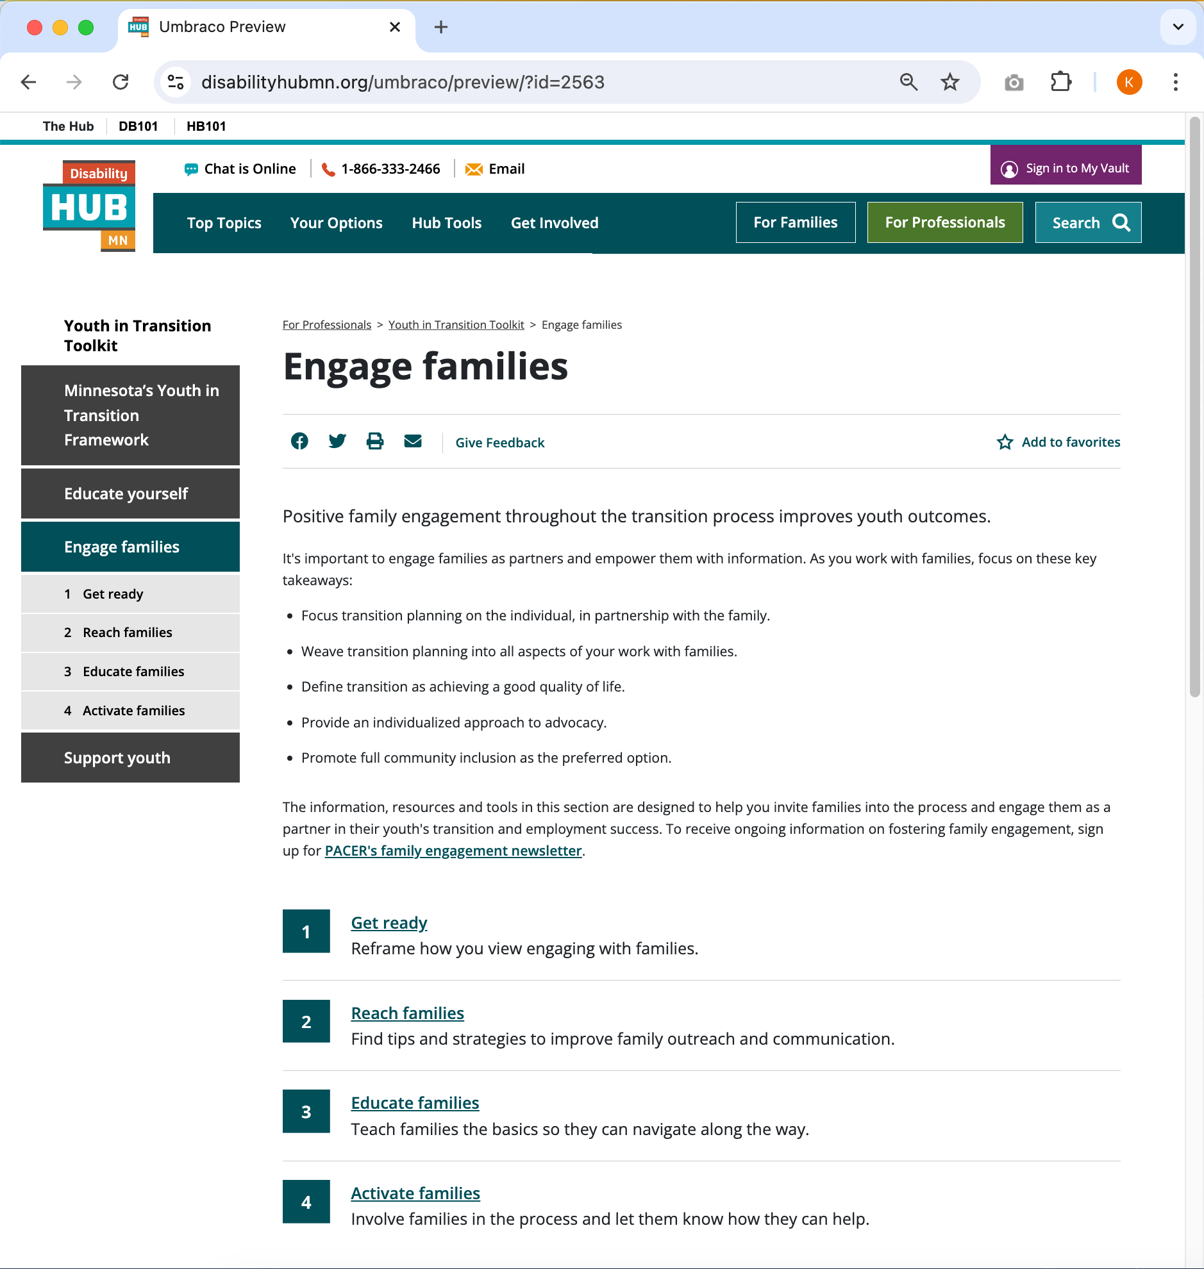
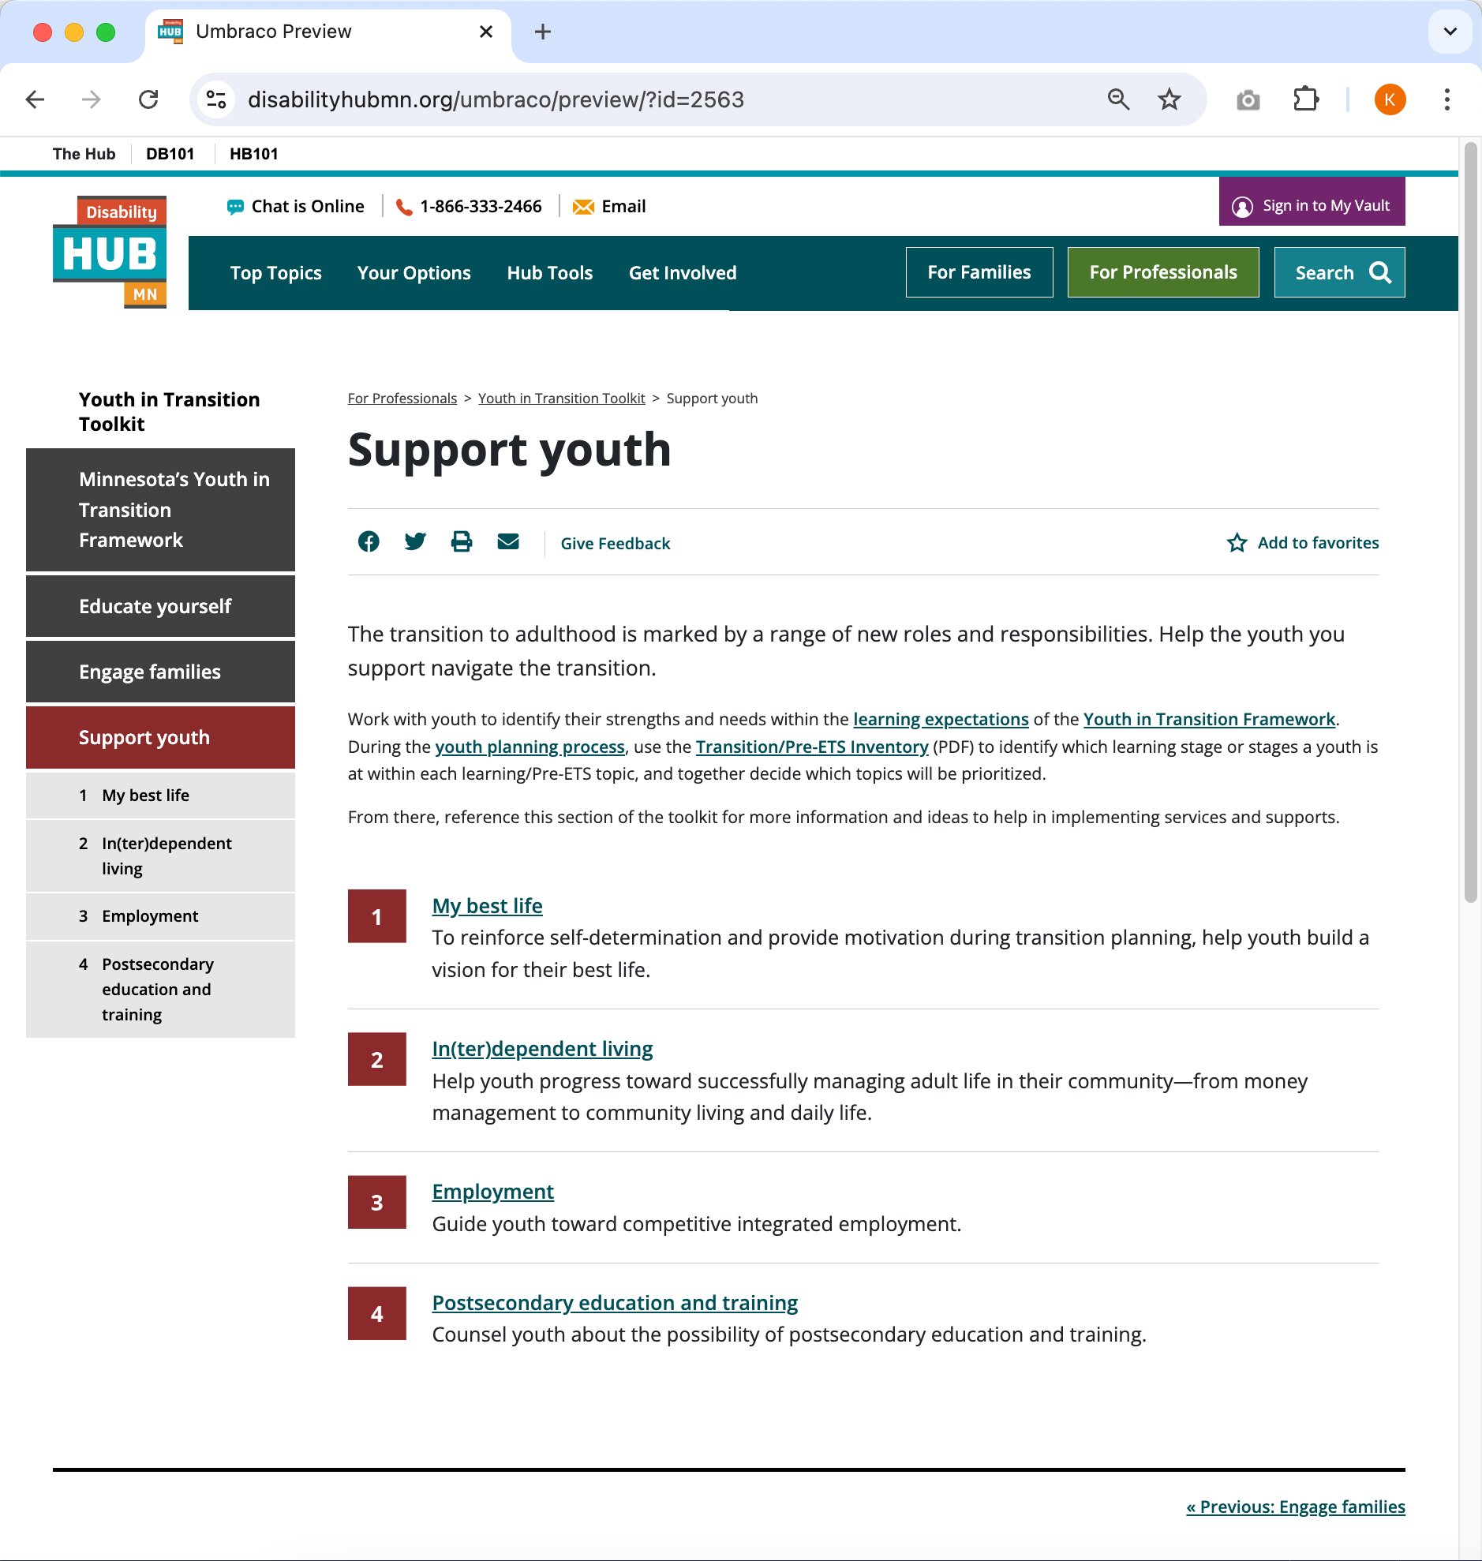
Educate yourself, Engage families and Support youth
THE YOUTH IN TRANSITION TOOLKIT
Professionals can use these sections of the toolkit to:
Learn about the youth planning process
Get basic information about plans, policies, services and roles
Find resources for their own professional development
Engage families as partners in their youth’s transition success
Find information, ideas and practical, hands-on tools to support youth
Notes:
Direct links to these pages:
Educate yourself: https://disabilityhubmn.org/for-professionals/youth-in-transition/educate-yourself/
Engage families: https://disabilityhubmn.org/for-professionals/youth-in-transition/engage-families/
Support Youth: https://disabilityhubmn.org/for-professionals/youth-in-transition/support-youth/

Slide 14
Thank you for being part of the movement of professionals across the state of Minnesota working together toward quality transition planning and consistent outcomes for youth.

